Slide 1
VX 420: Business Basics for Entrepreneurship
The Lean LaunchPad: Resources, Activities & Costs
Version 6/15/12

Slide 2
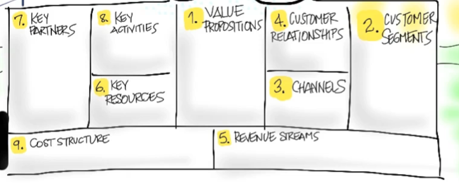
Key Activities
What’s Most Important for the Business?

Slide 3
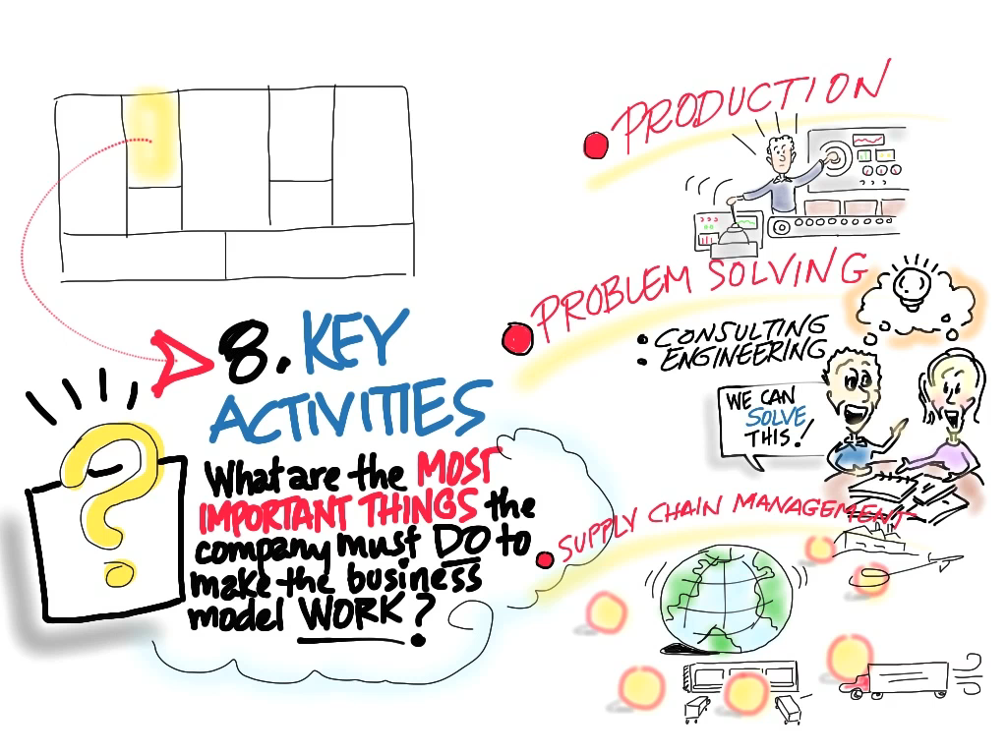
© 2012 Steve Blank

Slide 4
Key Resources
What’s Are Your Most Important Assets?

Slide 5
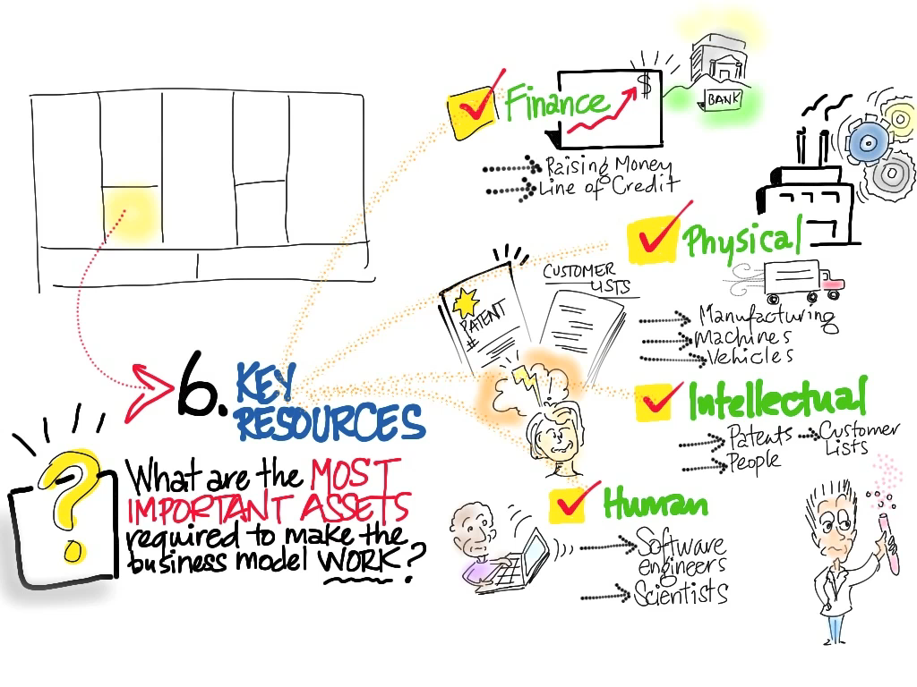

Slide 6
Cost Structure
What are the Costs and Expenses

Slide 7
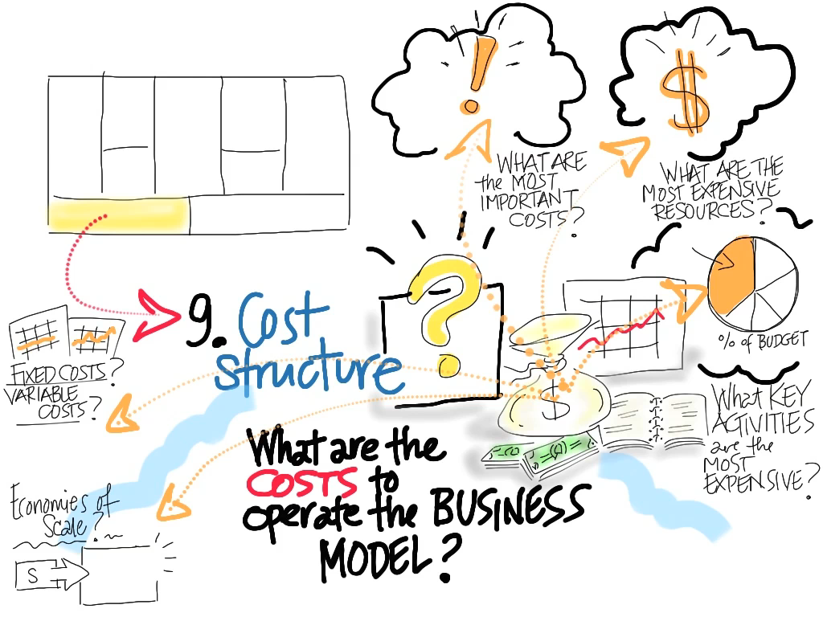
© 2012 Steve Blank

Slide 8
Key Resources

Slide 9
Four Critical Resources
Physical
Financial
Human
Intellectual

Slide 10
Physical Resources
company facilities
office space, company location
product/services
supply of silicon wafers or iron ore, or thousands of feet of warehouse space?
Many physical goods are capital intensive

Slide 11
Financial Resources
Friends and Family
Crowdfunding
Angels
Venture Capital
Corporate partners
Others: SBA or SBIR grants
Lease-lines
Factoring
Vendor-financing

Slide 12
Human Resources
qualified employees
mentors, teachers, coaches, advisors

Slide 13
Mentors, Teachers, Coaches
Mentors, teachers, coaches advance your personal career
If you want to learn a specific subject find a teacher
If you want to hone specific skills or reach an exact goal hire a coach
If you want to get smarter and better over your career find someone who cares about you enough to be a mentor

Slide 14
Advisors
Advisors are people you need to help advance your company’s success
Founders fail when they believe their visions are facts
Listening to experienced advice can help you sort through whether your vision is a hallucination
Getting an advisory board (by expanding your circle of accumulated wisdom past their investors) is so important that it’s an explicit step in the Customer Development process

Slide 15
Qualified Employees/Culture
Are the difference between a good idea that never went anywhere and a billion dollar firm

Slide 16
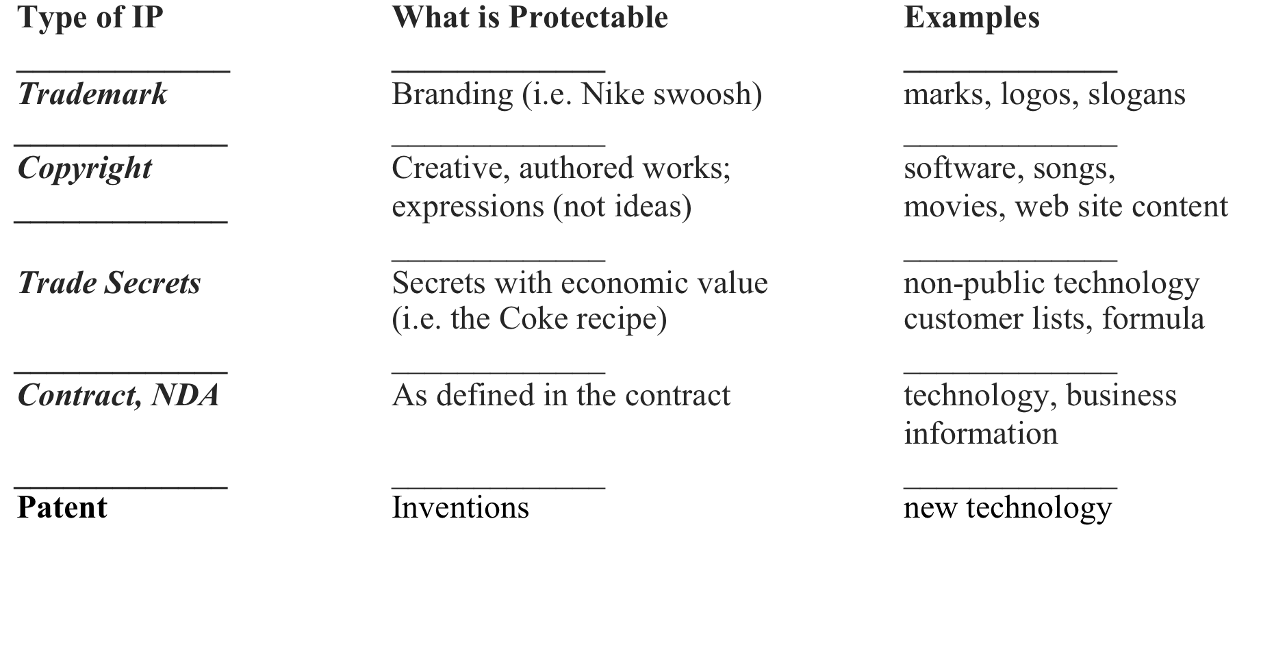
Intellectual Property

Slide 17
Trademark protects branding & marks
Trademark gives you the right to prevent others from using “confusingly similar” marks and logos
Trademark protection lasts as long as you use the mark
The more you use the mark, the stronger your protection
Trademark registration is optional, but has significant advantages if approved
Country by country

Slide 18
Copyright protects creative works of authorship
Copyright gives right to prevent others from copying, distributing or making derivatives of your work
Protects “expressions” of ideas but does not protect the underlying ideas
(Way) more than just technology:
songs, books, movies, photos, etc.
Copyright protection lasts practically forever
Copyright does not prevent independent development
Registration is optional, but is required to sue for infringement

Slide 19
Trade Secrets
Information that is kept secret and has economic value to the business
Coke recipe, customer lists, product road maps.
No registration required
Can last for as long as you take reasonable steps to keep confidential

Slide 20
Contract
Protection agreed to by contract
No registration process
You have whatever protection is defined in the contract (e.g., NDA gives you certain rights to protection of your confidential information)
The protection lasts for the time period defined in the contract

Slide 21
Patents
A government granted monopoly
prevents others from making, using or selling your invention
Even if the other’s infringement was innocent or accidental
Invention must be non-obvious
Protection lasts typically for 15-20 years
Application and examination is required
Typical cost for application and exam is $10-30k
Typical time for application and exam is 1-4 years
Must file in U.S. within one year of sale, offer for sale, public disclosure or public use
Provisional application alternative

Slide 22
What Can be Patented?
Just about anything . . .
Circuits, hardware
Software, applied algorithms
Formulas, designs
User interfaces
Applications, systems
Business processes (sometimes)
But not these . . .
Scientific principles
Pure mathematical algorithms
And, pending Supreme Court Case raises concerns regarding patentability of “methods” inventions

Slide 23
Costs
Metrics that Matter

Slide 24
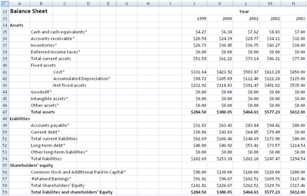
Search vs. Execution Metrics
Existing companies execute plans
Startups search for them
Income Statement, Balance Sheet, etc are execution documents
You first need to derive the metrics that matter

Slide 25
Metrics That Matter
• Value proposition: product cost, mkt size/share, competition?
• Customer Relationships: customer acquisition costs, conversion rates, lifetime value?
• Market Type: revenue curves
• Operating Costs: basic operating costs of the business?
• Channel: Channel margin, promotion, shelf-space charges?
Revenue Streams: average selling price, # of customers/year, achievable revenue?
• Burn Rate: per month? When will the company run out of cash?

Slide 26
Apple
Resource, Activities & Cost Example

Slide 27








Product User
Digital Hub
Digital Lifestyle
Digital Platform
PARTNER
NETWORK
KEY
ACTIVITIES
VALUE
PROPOSITON
CUSTOMER RELATIONSHIPS
CUSTOMER
SEGMENTS
component makers, shipping & logistic suppliers
build whole devices both h/w & s/w
differentiated markets
solutions for differentiated customers - professional & consumer
High-end mass market
control the supply chain
increase switching costs
increase switching costs - integration
audio-visual content producers & record labels
increased switching costs - shared information
software developers
optimize supply chain
purchase & mgmt of digital music, audio, video
app & game developers & cellular operators
KEY
RESOURCES
DISTRIBUTION CHANNELS
app & game developers
brand - Apple, PowerMac, iMac
Integrated phone, games & apps across devices
online store
iPod, iTunes software & content agreements
iTunes store
all digital devices linked through software platform
book publishers & developers of digital content
book publishers & developers of digital content
content agreements - games & apps
content agreements with book publishers
iTunes through wi-fi access
iTunes bookstore
COST STRUCTURE
REVENUE STREAMS
Invest in R&D
Computers, software & services
iPhone, apps & related services
increased investment in R&D
iPod, music & related products
iPad, apps, books & related services
reduce cost of sales

Slide 28
Product User
Digital Hub
Digital Lifestyle
Digital Platform
PARTNER
NETWORK
KEY
ACTIVITIES
VALUE
PROPOSITON
CUSTOMER RELATIONSHIPS
CUSTOMER
SEGMENTS
component makers, shipping & logistic suppliers
build whole devices both h/w & s/w
differentiated markets
solutions for differentiated customers - professional & consumer
High-end mass market
control the supply chain
increase switching costs
increase switching costs - integration
audio-visual content producers & record labels
increased switching costs - shared information
software developers
optimize supply chain
purchase & mgmt of digital music, audio, video
app & game developers & cellular operators
KEY
RESOURCES
DISTRIBUTION CHANNELS
app & game developers
brand - Apple, PowerMac, iMac
Integrated phone, games & apps across devices
online store
iPod, iTunes software & content agreements
iTunes store
all digital devices linked through software platform
book publishers & developers of digital content
book publishers & developers of digital content
content agreements - games & apps
content agreements with book publishers
iTunes through wi-fi access
iTunes bookstore
COST STRUCTURE
REVENUE STREAMS
Invest in R&D
Computers, software & services
iPhone, apps & related services
increased investment in R&D
iPod, music & related products
iPad, apps, books & related services
reduce cost of sales

Slide 29
Product User
PARTNER
NETWORK
KEY
ACTIVITIES
VALUE
PROPOSITON
CUSTOMER RELATIONSHIPS
CUSTOMER
SEGMENTS
component makers
build whole devices both h/w & s/w
differentiated markets
High-end mass market
solutions for differentiated customers - professional & consumer
Shipping & logistic suppliers
software developers
software developers
KEY
RESOURCES
DISTRIBUTION CHANNELS
brand - Apple, PowerMac, iMac
Wholesalers, retailers, re-sellers
innovative designers
online store
IP & patents & agreements
COST STRUCTURE
REVENUE STREAMS
Invest in R&D
Computers, software & services

Slide 30
Product User
Digital Hub
PARTNER
NETWORK
KEY
ACTIVITIES
VALUE
PROPOSITON
CUSTOMER RELATIONSHIPS
CUSTOMER
SEGMENTS
control the supply chain
control buying experience
audio-visual content producers
purchase & mgmt of digital music, audio, video
increase switching costs
record
labels
KEY
RESOURCES
integration of information across devices
DISTRIBUTION CHANNELS
iPod, iTunes software & content agreements
iTunes store
retail stores
chain of owned stores
COST STRUCTURE
REVENUE STREAMS
increased investment in R&D
iPod, music & related products

Slide 31
Product User
Digital Hub
Digital Lifestyle
PARTNER
NETWORK
KEY
ACTIVITIES
VALUE
PROPOSITON
CUSTOMER RELATIONSHIPS
CUSTOMER
SEGMENTS
specialized services in retail stores
optimize supply chain
games & apps across devices
app & game developers
increase switching costs - integration
easy access & purchase through iTunes
cellular network operators
KEY
RESOURCES
DISTRIBUTION CHANNELS
app & game developers
iPhone
integrated phone
iTunes through wi-fi access
content agreements extended to games & apps
COST STRUCTURE
REVENUE STREAMS
reduce cost of sales
iPhone, apps & related services

Slide 32
Product User
Digital Hub
Digital Lifestyle
Digital Platform
PARTNER
NETWORK
KEY
ACTIVITIES
VALUE
PROPOSITON
CUSTOMER RELATIONSHIPS
CUSTOMER
SEGMENTS
control customer experience in resellers’ stores
all digital devices linked through software platform
Premium re-sellers
increased switching costs - shared information
book publishers
KEY
RESOURCES
DISTRIBUTION CHANNELS
book publishers
iPad & related services
premium resellers
3rd party developers of digital content
developers of digital content
content agreements with book publishers
iTunes bookstore
COST STRUCTURE
REVENUE STREAMS
iPad, apps, books & related services

